Slide 1
Natural Variables vs. Renewable Energy
Ignacio Domaica, Jason Amaya,
Gregory Gibbs

Slide 2
Motivation & Summary
Analysis of renewable power generation in random locations in USA.
What effect natural variables have on the output consumption of Renewable energy?

Slide 3
Data
Generation of Latitude and Longitude random sets with numpy python library
Use Citypy to look for nearest city with geo coordinates.
Perform API calls with Openweathermap to access json meteorologic data
Filter to get USA data
Sample size of US Cities (260-290). Around 10% of cities in USA over 500 unhabitants (28.700)
Data cleansing (records skipped, drop NaN values, duplicates, index resetting, etc)
Get elevation with reverse geocoding with google API maps, elevation. Obtain altitude (m)
Represent some maps with markers for USA cities, heat layers for wind and altitude
Get additional data from (https://simplemaps.com/data/us-cities) like
state_id
State
timezone
Get additional data from (https://www.currentresults.com/Weather/US/weather-averages-index.php) like
Sun Radiation (h)
Precip_inch
Precip_mm
Get additional data from (https://www.currentresults.com/Weather/US/weather-averages-index.php) like
mean elevation feet
mean elevation meters
Get additional data from (https://www.currentresults.com/Weather/US/weather-averages-index.php) like
Hydro cons (BTU)
Solar cons (BTU)
Wind cons (BTU)

Slide 4
Data Cleanup & Exploration
Display Graphs Here

Slide 5
Data Analysis
Matplotlib/Linear Regression?
Solar Radiation vs. Renewable
Avg. Wind Velocity vs. Renewable ?
Avg. Humidity vs. Renewable?
Elevation vs. Renewable ?

Slide 6
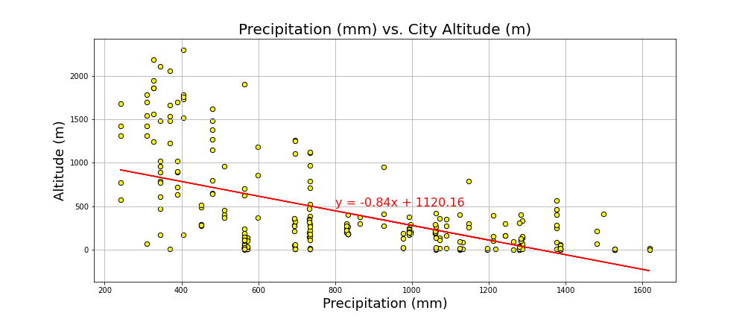
Precipitation vs Altitude. Correlation and regression
The correlation between both factors is: -0.58
Typically closest to 1 or -1. Bigger than 0.75 or smaller than -0.75

Slide 7
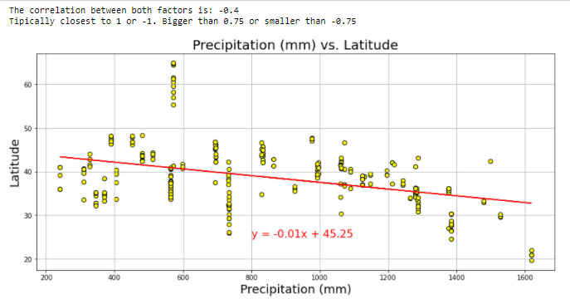
Precipitation vs Latitude. Correlation and regression

Slide 8
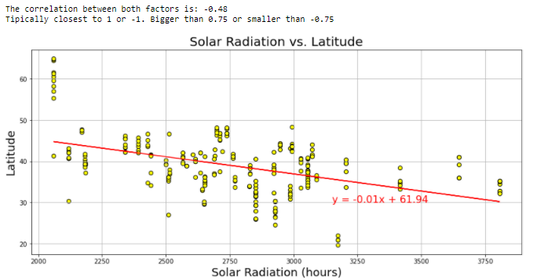
Solar Radiation vs Latitude Plot. Correlation. Regression

Slide 9
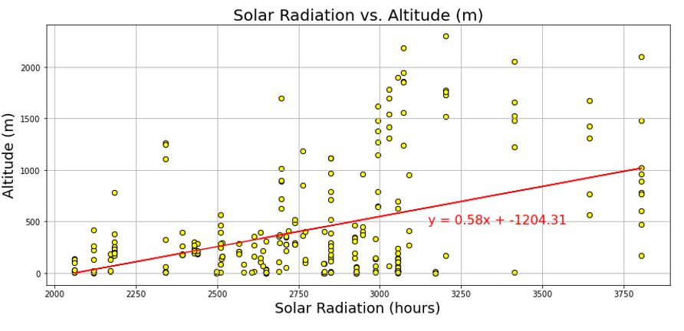
Solar Radiation vs Altitude Plot. Correlation. Regression
The correlation between both factors is: 0.44 Typically closest to 1 or -1.
Bigger than 0.75 or smaller than -0.75

Slide 10
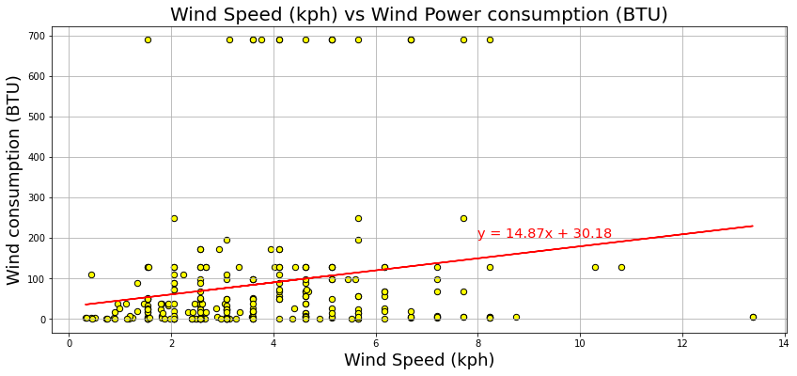
Wind Speed (kph) vs Wind Power consumption Plot. Correlation. Regression
The correlation between both factors is: 0.19
Tipically closest to 1 or -1. Bigger than 0.75 or smaller than -0.75

Slide 11
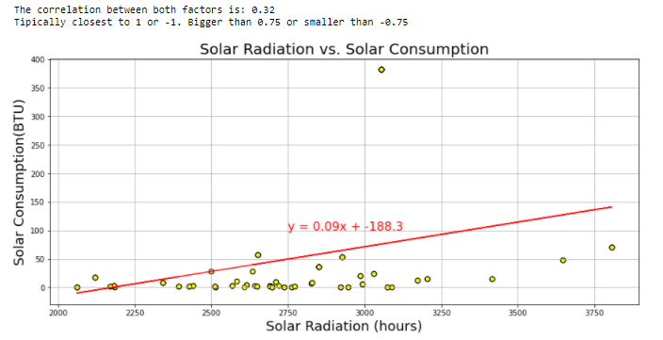
Solar Radiation vs Solar consumption. Correlation. Regression

Slide 12
Discussion
Findings:
How close to hypothesis?

Slide 13
Post Mortem
Difficulties?
What would we do if given more time?

Slide 14
BACK UP

Slide 15
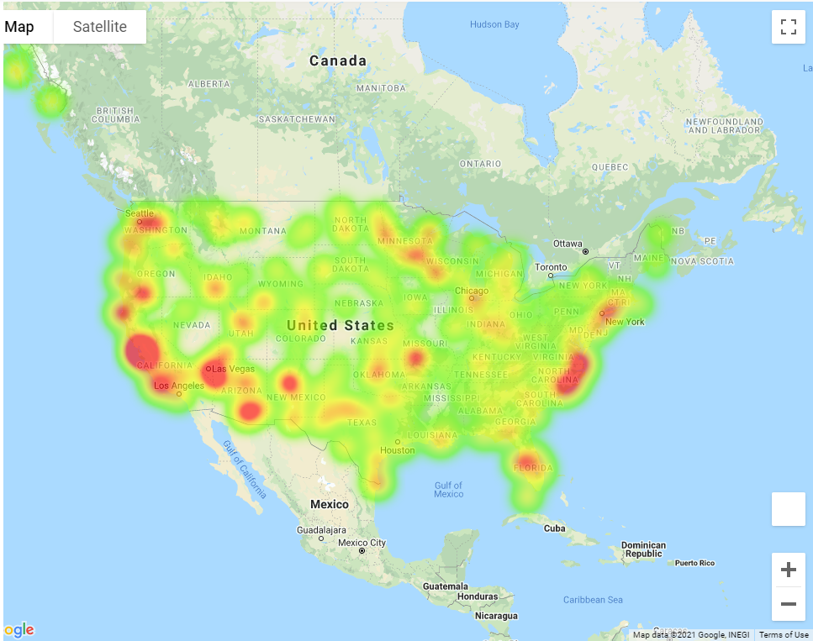

Slide 16
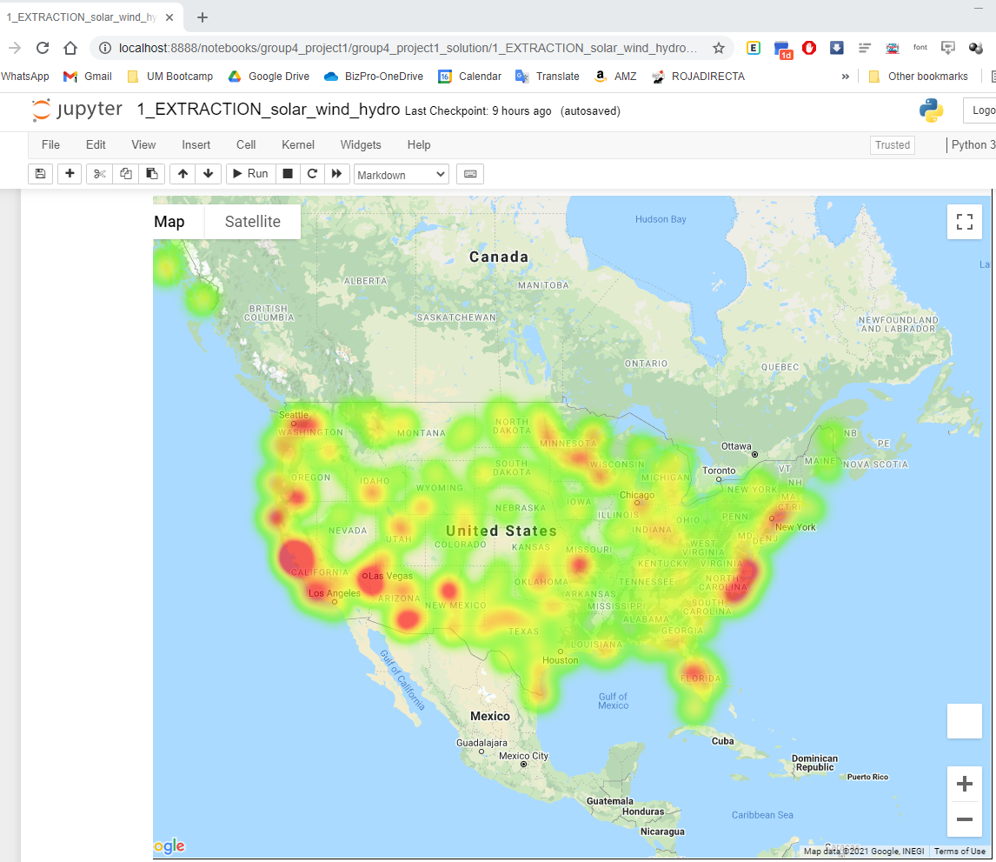

Slide 17
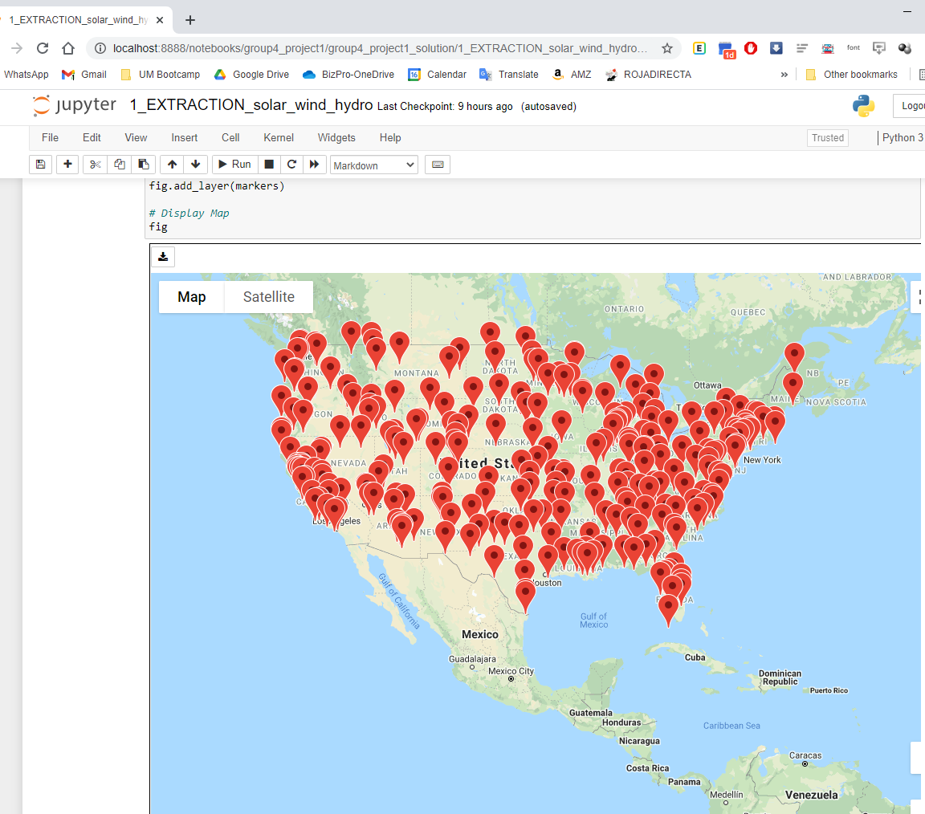

Slide 18
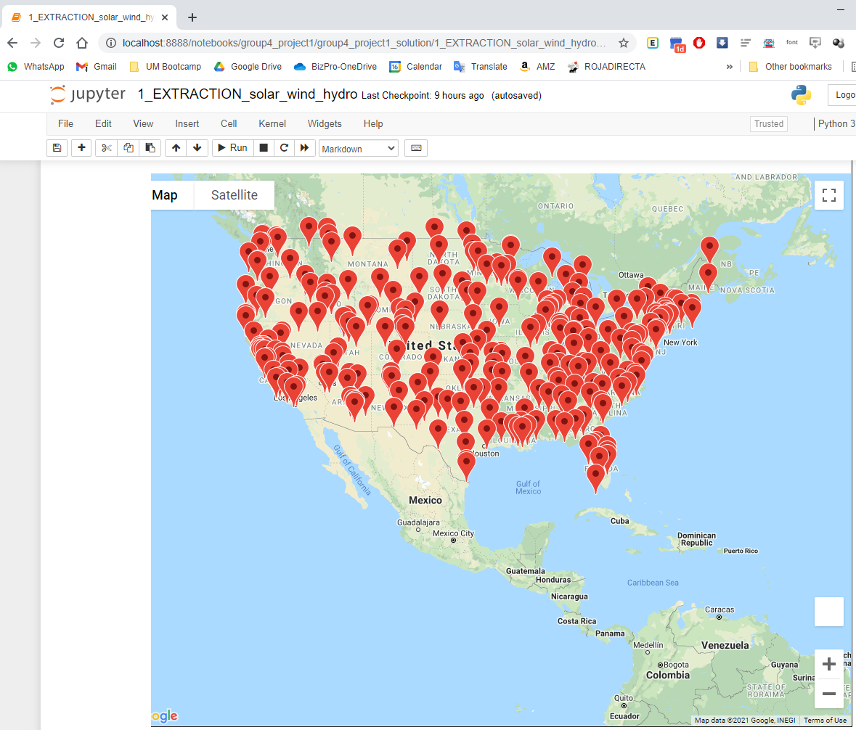

Slide 19
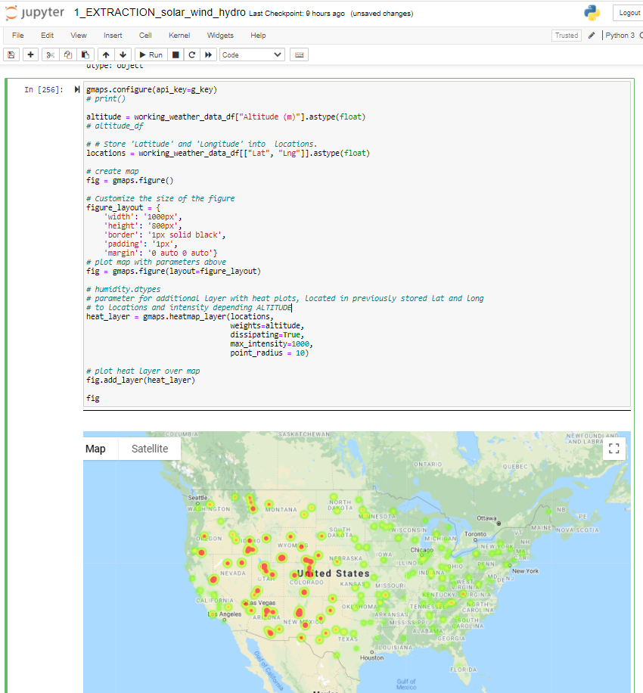

Slide 20
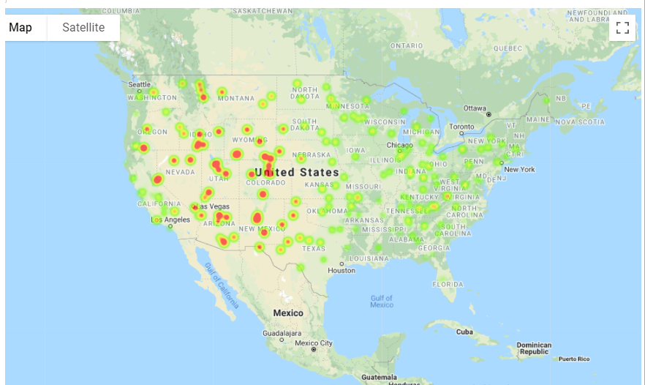

Slide 21
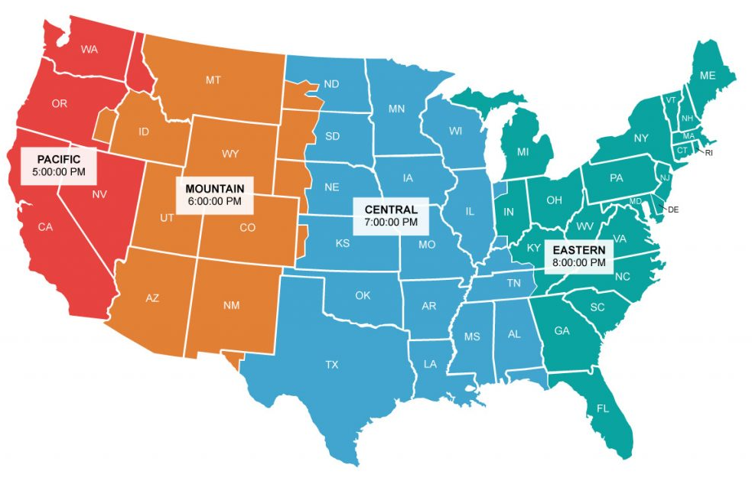

Slide 22
